Slide 1
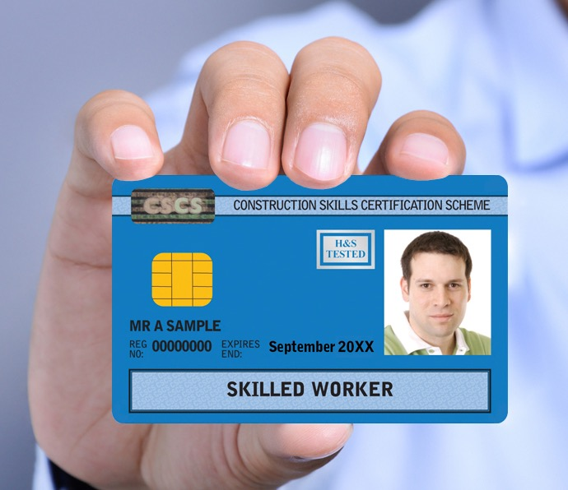

Industry Accreditation Webinar
Alan O’Neile Head of Communications
Garry Mortimer Head of Operations

Slide 2


Strategic direction
Proof of training and qualifications
Improving standards and safety
2 key criteria:
Nationally recognised construction related qualification
CITB Health, Safety and Environment test (or alternative)
Over 2 million cards in circulation.

Slide 3
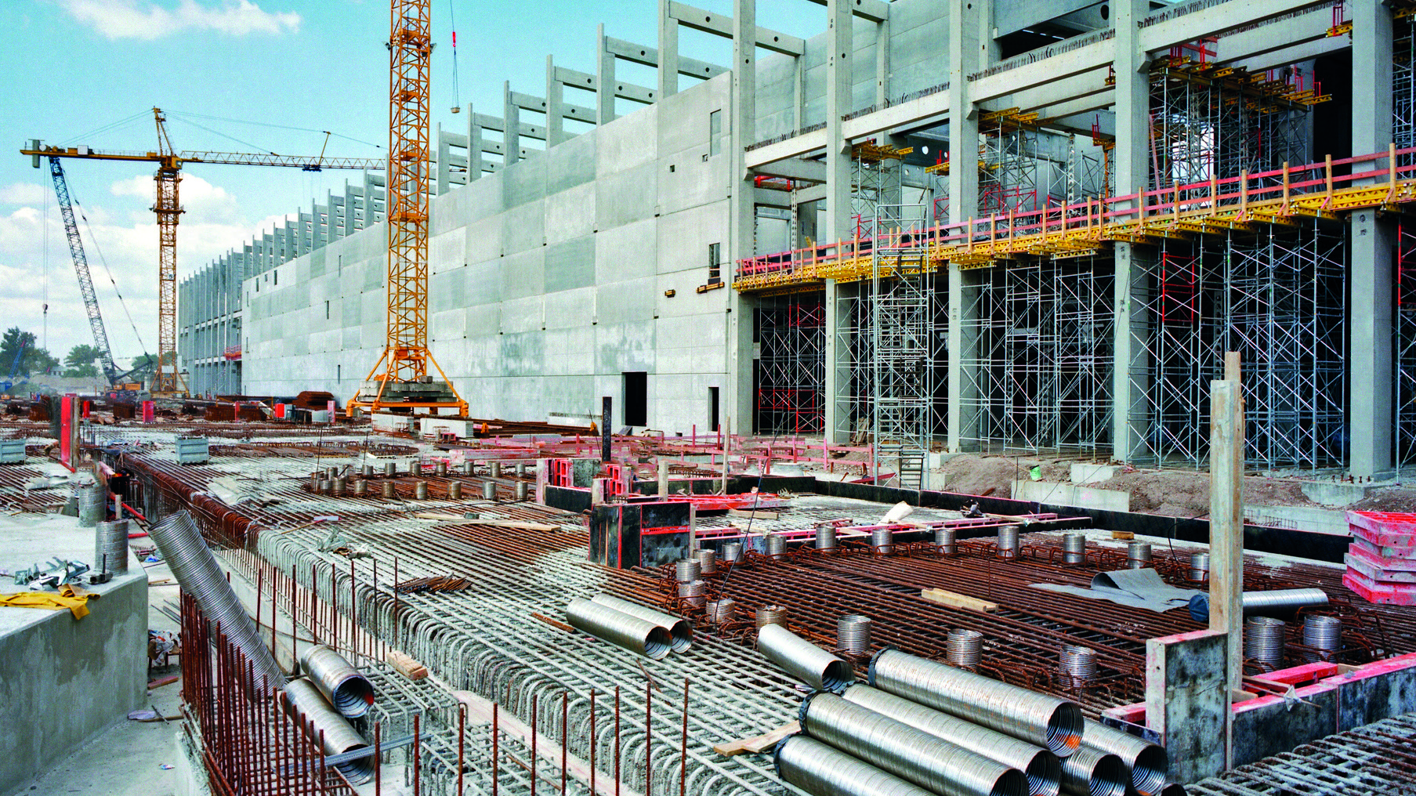

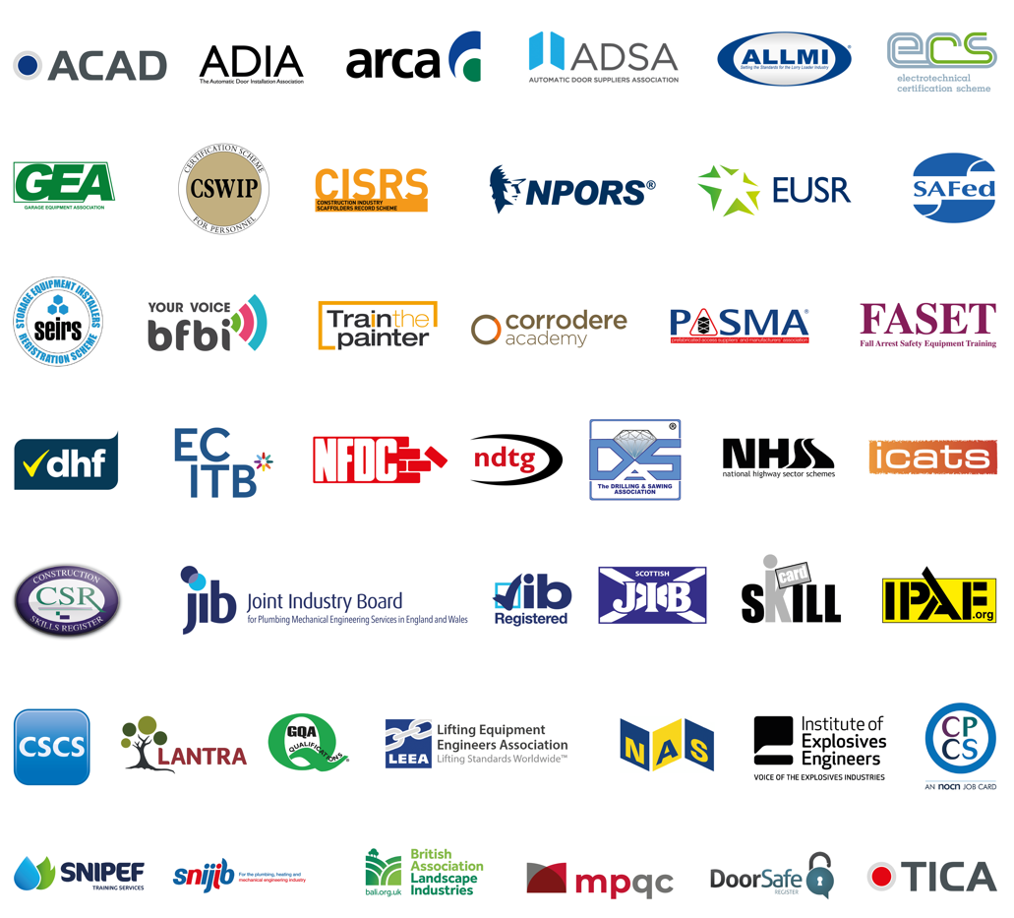

Slide 4

Industry Accreditation
60,000 and slowly reducing
Cards expire end of 2024
Existing straightforward routes off IA
Qualifications (including academic)
Professional Body membership
No longer require a card
Individuals need guidance and support to move off IA.

Slide 5
Industry Task Group
Build UK, CIOB, CITB, CSCS, Keir, NOCN & SQA
Setting out available support:
On Site Assessment (OSAT)
Professional Discussion
Do not need to attend college
Grants up to £1500
Programme of direct engagement:
Reassure and support
www.cscs.uk.com/ia

Slide 6


CSCS Smart Check app
CLC 2020:
“……..all card schemes must use smart technology ….. using a common interface, without the need to manually enter data.”
App launched April 2022
Benefits
Free
Improved card checking practices
Tackles fraud – ensures cards genuine/in date
Ensures workers hold correct training and quals
Leads to improved standards and safety

Slide 7

My CSCS
App launched in 2020
Benefits
Free
Access to Virtual CSCS card
Update contact information
Support
Apply for CSCS cards

Slide 8
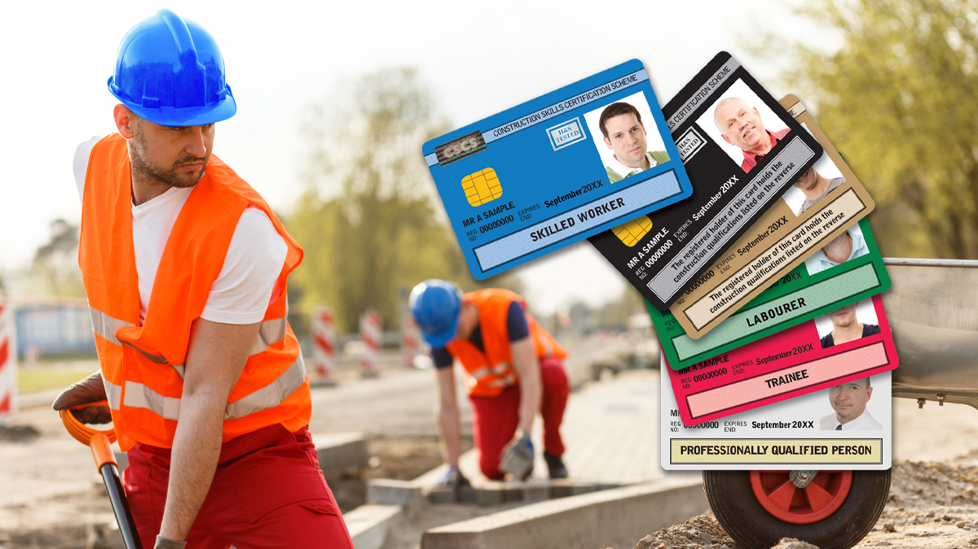
Priorities
Building Safety Act: Fire Safety Training / CPD
Tackle fraud
Phase 2: CSCS Smart Check
Industry Accreditation – direct engagement

Slide 9

Questions

